Slide 1

Unit 4: Storage Technologies
DAS, NAS, SAN, protocols, devices, interfaces, RAID and capacity planning

Slide 2

What is Storage?
Definition
Technology used to permanently or temporarily store digital data
What we store
Operating systems and applications
Documents and databases
Images and videos
Backups and logs
How storage is classified
Location
Connection method
Technology
Performance and capacity
Racks of server and storage hardware in a data center
Location
Connection
Technology
Performance
Capacity
2

Slide 3
Storage Hierarchy
CPU Registers
Fastest, very small capacity
Cache
Very fast temporary storage
RAM
Fast but volatile
SSD
Fast persistent storage
HDD
Large capacity, lower cost
Tape
Huge archival capacity, slow access
More capacity, cheaper per GB
Faster, costlier per GB
Rule: faster storage generally costs more per GB; slower storage generally costs less per GB.
3

Slide 4
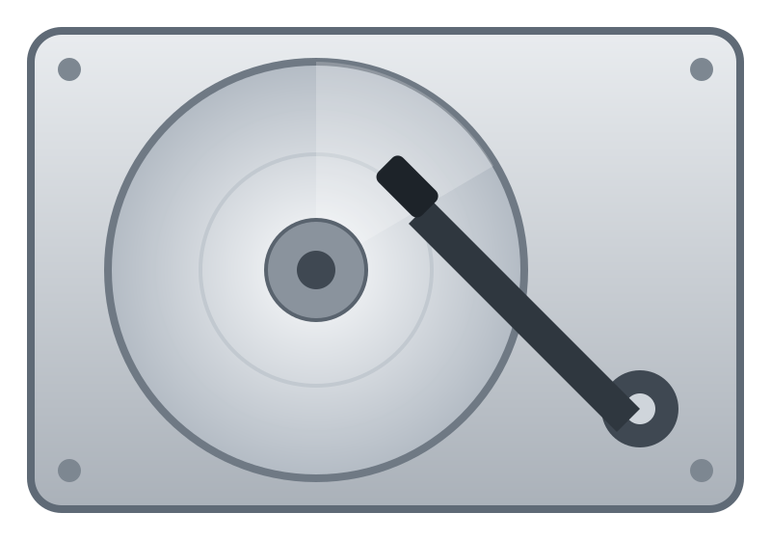
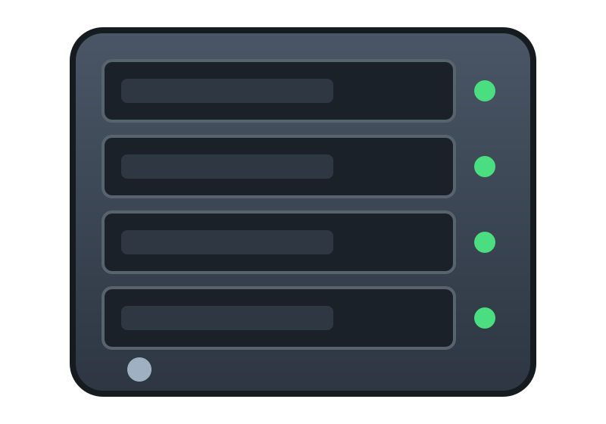

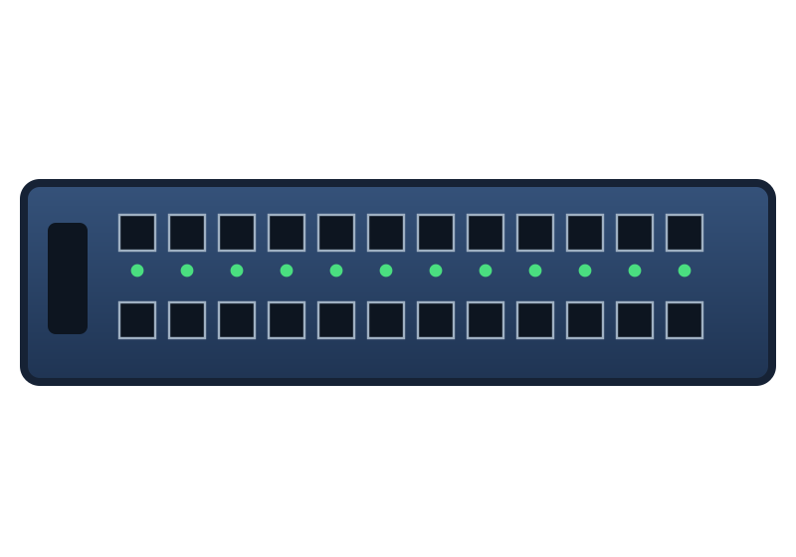
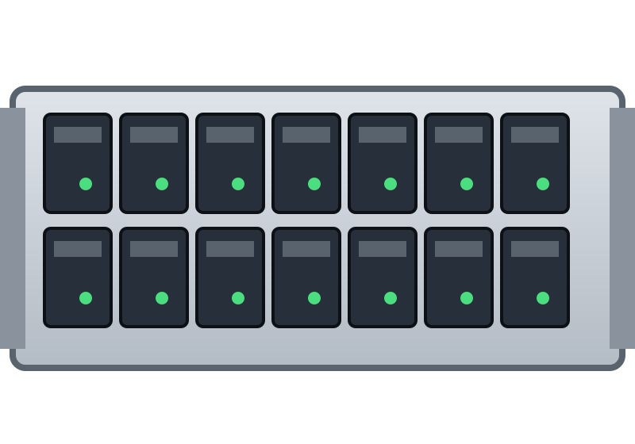
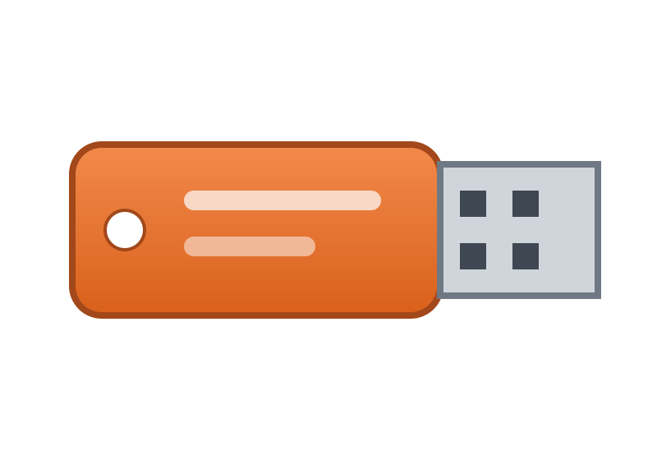
Local vs Network Storage
Local storage
Network storage
NAS
Internal HDD
Users
Network
Computer
SAN
Directly connected, direct access
External USB drive
Shared or centralized access
Key Point: local storage provides direct access; network storage provides shared or centralized access.
4

Slide 5
What is Storage Architecture?
Definition
The planned design of how storage hardware, software, networks and policies fit together to hold, protect and deliver an organization's data to its applications and users.
Purpose
Store fast-growing business data in an organized, predictable way
Keep data available, consistent and protected from failures
Give applications and users quick access to the data they need
Control cost by matching each type of data to the right storage
Layers of a storage architecture
Applications and users
Databases, email, file sharing, virtual machines
Servers and file systems
Volumes, file systems, volume managers
Storage network and protocols
Fibre Channel, iSCSI, NFS, SMB, SAS
Controllers and RAID
Cache, RAID, snapshots, replication
Physical media
SSD, HDD and tape
Key Point: storage architecture is the blueprint that turns raw disks into a managed, reliable, shared data service.
5
Notes:
Storage architecture is the overall design of how an organization stores, protects and delivers its data. It describes the layers involved - applications, servers and file systems, the storage network and protocols, controllers with RAID, and the physical media - and the policies that tie them together. Its purpose in an enterprise is to keep data organized, available, protected and quickly accessible while controlling cost. Think of it as the blueprint that turns individual disks into a reliable, shared data service.

Slide 6
How Storage Architecture Helps
Organizing
Gives data a logical structure
Tiers data by value: SSD for hot data, HDD for warm, tape or cloud for archive
Groups storage into volumes, LUNs and file shares for each application
Separates databases, user files and backups so each gets the right policy
File systems and naming make data easy to find and share
Managing
Keeps the environment under control
Central provisioning, quotas and capacity planning
RAID, snapshots, backup and replication protect against failures
Monitoring and alerts catch problems early
Access control and encryption secure the data
Efficient access
Delivers data quickly to those who need it
Right protocol: block (SAN) for databases, file (NAS) for shared files
Caching and SSD tiers reduce latency
Multiple paths and load balancing avoid bottlenecks
Shared storage lets many servers use one pool
Result: data is organized, managed and delivered so that applications stay fast and the business keeps running.
6
Notes:
A good storage architecture helps in three connected ways. ORGANIZING: data is placed in tiers by value and performance (fast SSD for hot data, HDD for warm data, tape or cloud for archives) and grouped into volumes, LUNs and file shares so each application and data type gets the right policy. MANAGING: administrators provision capacity, set quotas, monitor health, and protect data with RAID, snapshots, backup and replication, while access control and encryption secure it. EFFICIENT ACCESS: the correct protocol (block for databases over a SAN, file for shared documents over NAS), caching, SSD tiers and multiple paths deliver data with low latency, and many servers can share one pool of storage.

Slide 7
Meeting Business Needs with Storage Architecture
Business need | Architectural approach | Outcome
Availability | RAID, redundant controllers, multipathing, hot spares | Service continues through disk or path failures
Performance | SSD tiers, caching, high-speed storage network | Low latency for databases and virtual machines
Scalability | Add drives, shelves or nodes to a shared pool | Capacity grows without redesign or downtime
Data protection | Snapshots, backup, replication, disaster recovery | Data can be recovered after loss or disaster
Security and compliance | Access control, encryption, auditing, retention | Sensitive data is protected and policies are met
Cost efficiency | Tiering, compression, shared pooling | Lower cost per GB and less wasted capacity
Key Point: every design choice trades off performance, protection and cost; architecture is how an enterprise balances them.
7
Notes:
Each business need maps to a design choice. Availability comes from RAID, redundant controllers, multipathing and hot spares. Performance comes from SSD tiers, caching and a fast storage network. Scalability comes from adding drives, shelves or nodes to a shared pool. Data protection relies on snapshots, backup, replication and disaster recovery. Security and compliance need access control, encryption, auditing and retention policies. Cost efficiency comes from tiering, compression and pooling so no capacity is wasted.

Slide 8
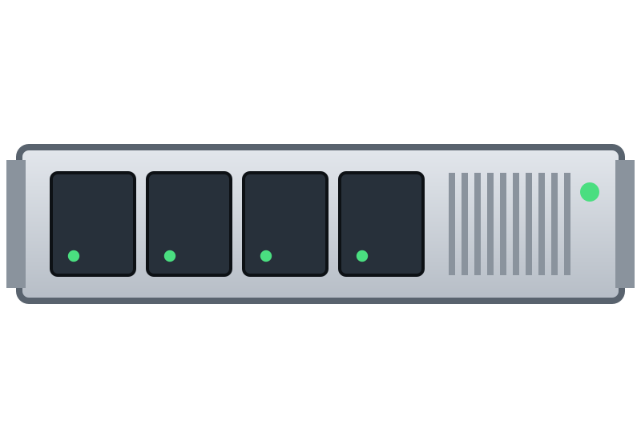
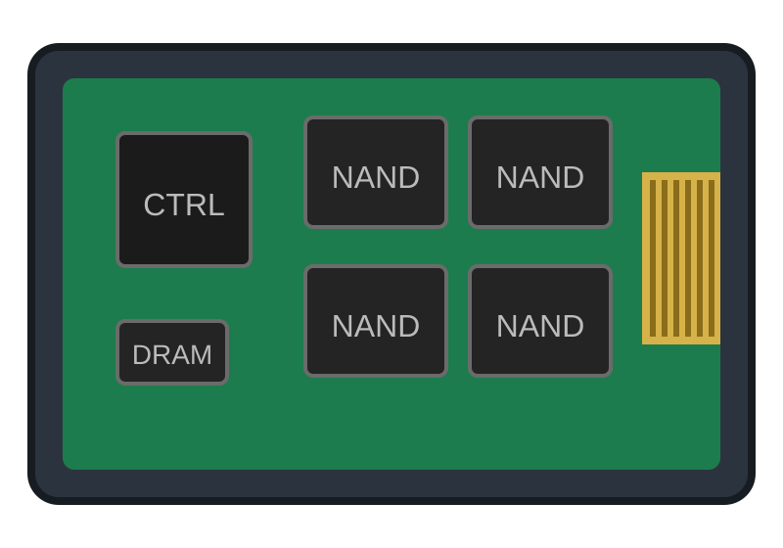
DAS: Direct Attached Storage
What is DAS?
Storage directly attached to a computer or server
Examples: internal HDD, internal SSD, external USB HDD, external SAS storage
Advantages
Simple configuration
Good performance
Low complexity, relatively inexpensive
Disadvantages
Limited sharing
Usually tied to a specific system
Scaling can become difficult
Server
direct cable
HDD
SSD
8

Slide 9
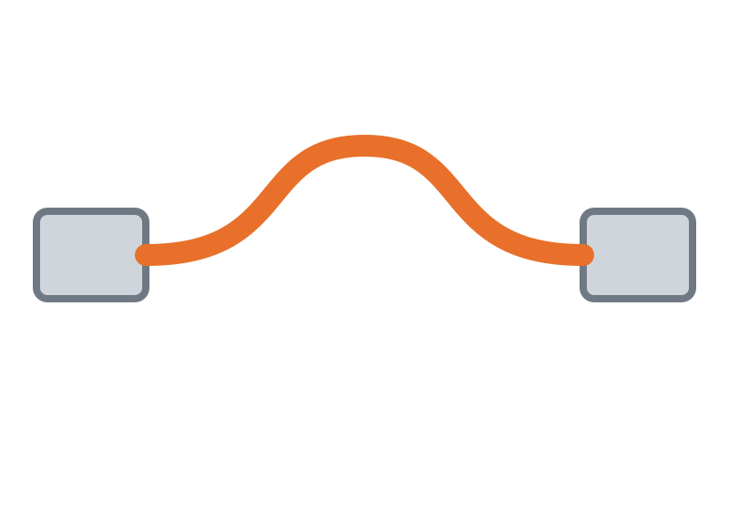
DAS Architecture
Storage Interface
Storage Device
Server
SATA, SAS, USB, SCSI
HDD or SSD
Common interfaces
SATA
SAS
USB
SCSI
Example: server → SATA controller → SSD/HDD. In practice: a laptop internal SSD or an external USB hard disk.
9

Slide 10
NAS: Network Attached Storage
What is NAS?
A dedicated storage device connected to a network
Provides centralized file storage, file sharing, backup and user access control
Protocols
SMB/CIFS
NFS
Example
Office employees storing files on a shared NAS
User 1
User 2
User 3
Network switch
Shared NAS
10

Slide 11
NAS Architecture
Client Computer
Network Switch
NAS Device
HDD / SSD Storage
A NAS typically contains
CPU
RAM
Network interface
Storage drives
Storage OS
Processes file requests
Caches and working memory
Connects to the switch
HDDs / SSDs
Manages shares and users
11

Slide 12
SAN: Storage Area Network
What is SAN?
A specialized high-speed network used to provide block-level storage
Appears to a server as block storage
Provides
Centralized storage
High performance and high availability
Scalability
Commonly used in
Data centers and enterprise environments
Virtualization platforms and databases
Enterprise storage and servers in racks
Key Point: a SAN is a network of its own, built to carry block-level storage traffic.
12

Slide 13
SAN Architecture
HBA
Application Server
HBA
Storage Array
SAN Switch
Application Server
Multiple HDDs / SSDs
Components
Servers
Host bus adapters
SAN switches
Storage arrays
SAN primarily provides block-level storage.
13

Slide 14
DAS vs NAS vs SAN
DAS
NAS
SAN
 | DAS | NAS | SAN
Connection | Direct connection | Over the network | Dedicated storage network
Access | Commonly block-level | File storage | Block-level access
Sharing | Limited sharing | High sharing capability | Centralized, shared
Cost / complexity | Lower cost, simple management | Moderate management complexity | High performance, enterprise-oriented
14

Slide 15
Real-World Examples
DAS
NAS
SAN
Laptop SSD or external USB HDD
Office file server or home media server
Enterprise virtualization or database infrastructure
One employee
Many employees sharing files
Large data center
Teaching example: one employee → DAS; many employees sharing files → NAS; large data center → SAN.
15

Slide 16
NAS Advantages over DAS; Block-level Storage
Advantages of NAS over DAS
NAS gives shared access over the network. Whears DAS is tied to one system
NAS can be used to centralized management of storage, users and backup
In NAS Multi-user can use file sharing with access control
Block-level storage
Storage presented as raw blocks to the operating system
The OS formats it and manages it with its own file system
A SAN provides block-level storage over a dedicated network
NAS provides file-level storage instead
Key Point: DAS is private to one server; NAS shares files over the network; SAN shares block storage over a storage network.
16

Slide 17
NAS vs SAN
Criterion | NAS | SAN
Access | File-level, over Ethernet (SMB/NFS) | Block-level, over Fibre Channel or iSCSI
Performance | Good for small teams; shared Ethernet and file-protocol overhead limit many heavy streams | Highest: dedicated low-latency network suits many simultaneous editors
Cost | Lower: uses existing Ethernet; simple appliance | Higher: HBAs, SAN switches, arrays
Management effort | Simple: shares and permissions | Higher: zoning, LUNs, skilled staff
Evaluation: choose SAN when many editors need guaranteed high-speed shared access; choose NAS when budget and simplicity matter more. Weigh performance against cost and effort.
17

Slide 18
What is a Storage Protocol?
Definition
Defines how a system communicates with storage
It determines
How data is transferred
How storage devices are addressed
How commands are sent
How errors are handled
commands
data / status
Server
Storage
Examples of storage protocols
iSCSI
Fibre Channel
FCoE
NVMe over Fabrics
18

Slide 19
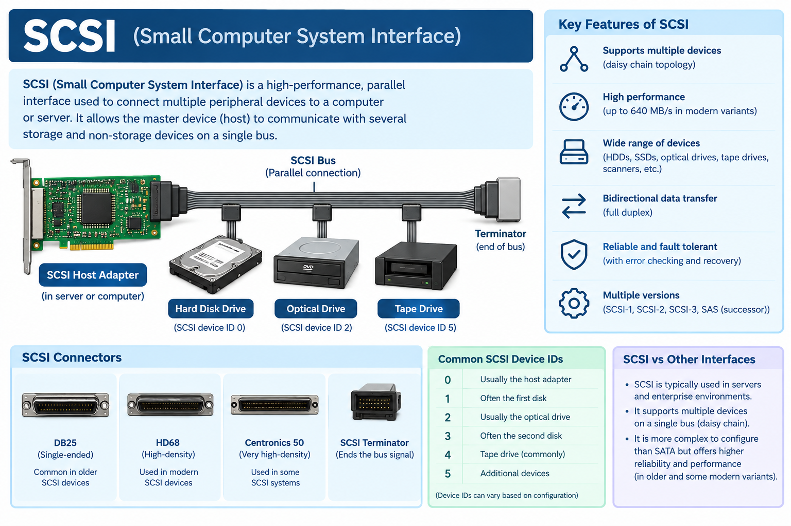

Slide 20
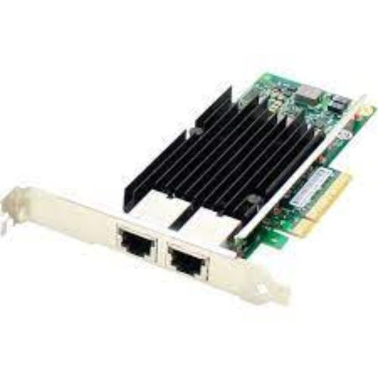
iSCSI
SCSI commands
Initiator
Ethernet / IP network
Target
Server requesting storage
TCP/IP
Provides the storage
iSCSI = Internet Small Computer Systems Interface
Transports SCSI storage commands over IP networks
Uses Ethernet and TCP/IP
A network adapter card (NIC) in the server carries iSCSI traffic
Advantage: iSCSI can use existing Ethernet infrastructure.
20

Slide 21
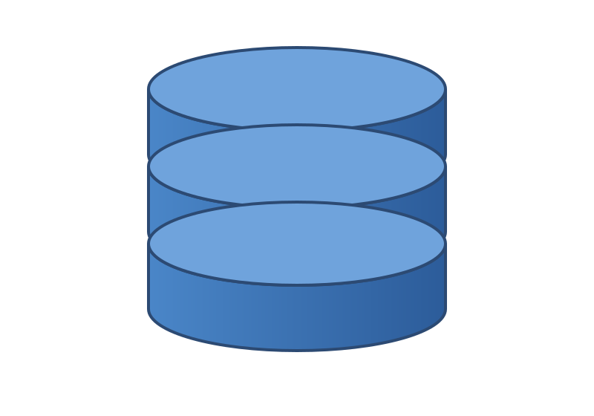
iSCSI Components
iSCSI Target (provides storage)
Ethernet
iSCSI Initiator
Client or server requesting storage
LUN 0
LUN 1
LUN 2
A LUN (Logical Unit Number) represents a logical storage device
Example: Server with iSCSI initiator → Ethernet → iSCSI target → LUN.
21

Slide 22
FCoE
Separate networks
Fibre Channel over Ethernet
Ethernet cable
Fibre Channel cable
LAN switch
one Ethernet cable
Server
Server
Ethernet switch
FC switch
Fibre Channel over Ethernet: carries Fibre Channel traffic over Ethernet
Consolidates network and storage traffic and reduces separate cabling
Used mainly in data-center and enterprise environments; needs suitable Ethernet infrastructure and hardware
22

Slide 23
iSCSI vs FCoE
iSCSI
FCoE
SCSI commands
SCSI commands
iSCSI
Fibre Channel protocol
TCP
FCoE encapsulation
IP
Ethernet
Ethernet
iSCSI: generally simpler to deploy using IP networking
FCoE: generally used in specialized data-center environments
23

Slide 24
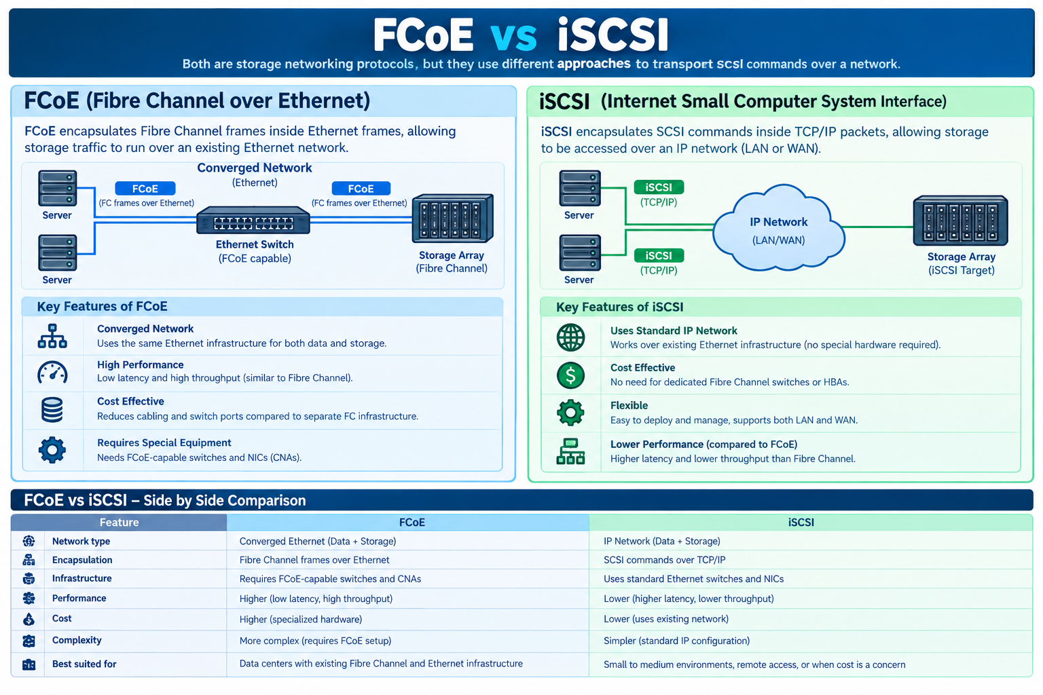

Slide 25
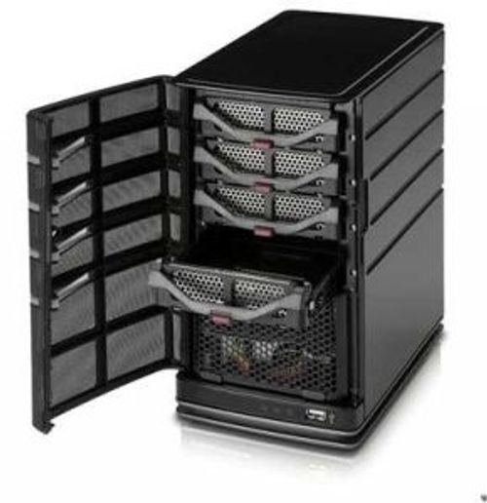
What is JBOD?
JBOD = Just a Bunch Of Disks
Multiple physical disks grouped in an enclosure
Not necessarily combined into a RAID array
Each disk can be independently accessed and managed
Important: JBOD is not automatically RAID.
Drive bays in a storage enclosure
25

Slide 26
JBOD vs RAID
JBOD: independent disks
RAID: disks combined by a defined method
Disk 1
Disk 2
Disk 3
Disk 4
Disk 1
Disk 2
Disk 3
Disk 4
Data 1
Data 2
Data 3
Data 4
A1
A2
Pa
A3
✕
B1
Pb
B2
B3
If one disk fails, the data stored on that disk is affected. No built-in redundancy.
RAID may provide redundancy depending on the RAID level.
Key Point: JBOD has no data organization method; RAID defines how data, copies and parity are laid out.
26

Slide 27
JBOD vs RAID
Aspect | JBOD | RAID
Method | Each disk works separately. | Multiple disks work together according to a RAID level.
Logical Volume | Each disk is usually accessed separately. | Disks may appear as one logical drive or multiple drives.
Redundancy | No automatic data protection. | Some RAID levels protect data if a disk fails; others do not.
Performance | Each disk works at its own speed. | Some RAID levels improve read or write speed.
If One Disk Fails | Data on the failed disk may be lost; other disks usually remain accessible. | The effect depends on the RAID level. Some can continue working after a disk fails.
Storage Capacity | Total capacity is available across separate disks. | Usable capacity depends on the RAID level.
Example | Two 1 TB disks store different files independently. | RAID 1 uses two 1 TB disks to mirror the same data, providing 1 TB usable capacity.
Key Point: both lack redundancy; RAID 0 defines a striping method and one volume, JBOD does not.
27

Slide 28
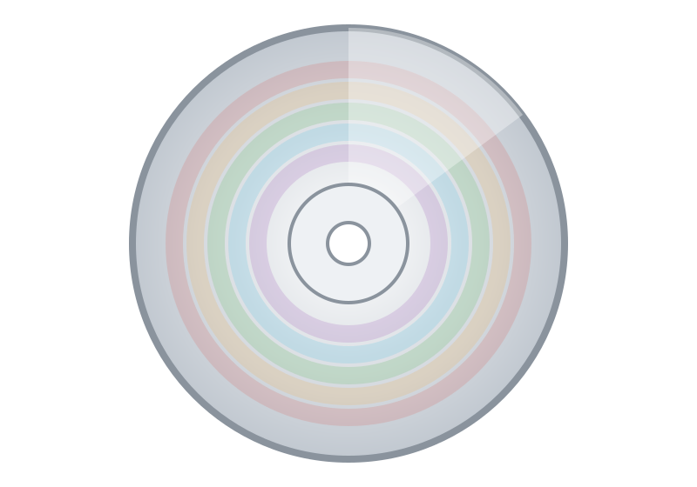
Storage Device Categories
Magnetic
Optical
Flash
Network
HDD and tape
CD, DVD and Blu-ray
SSD, USB flash drive, memory cards
NAS and SAN
Key Point: device category describes the technology; network storage describes how it is accessed.
28

Slide 29
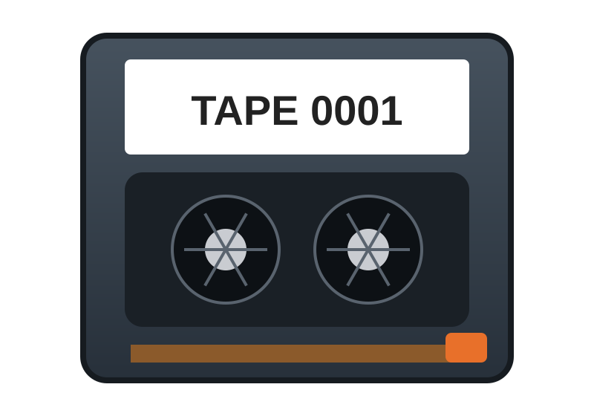
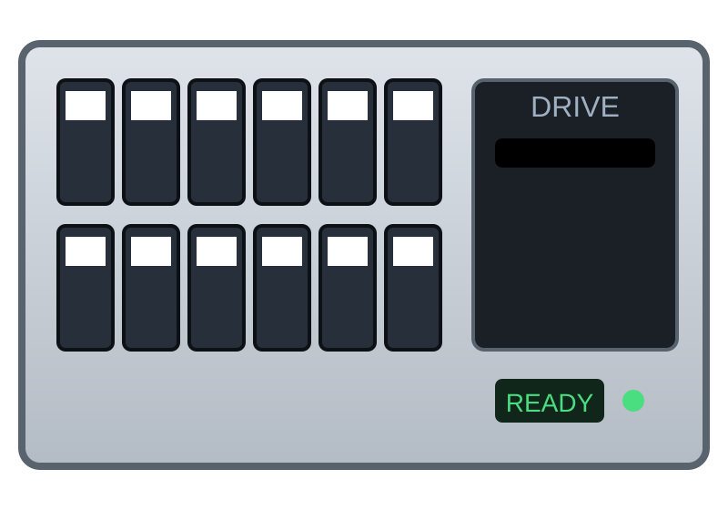
Tape Storage
What is it?
Uses magnetic tape to store data
Common uses: backup, archiving and long-term data retention
Advantages
Very high capacity and low cost per TB
Suitable for long-term storage
Can be stored offline
Disadvantages
Sequential access
Slow random access
Requires tape drives or libraries
Tape cartridge
Tape library
Sequential access
1
2
3
4
5
6
7
To reach block 6 the tape must wind past blocks 1 to 5, so random access is slow.
29

Slide 30
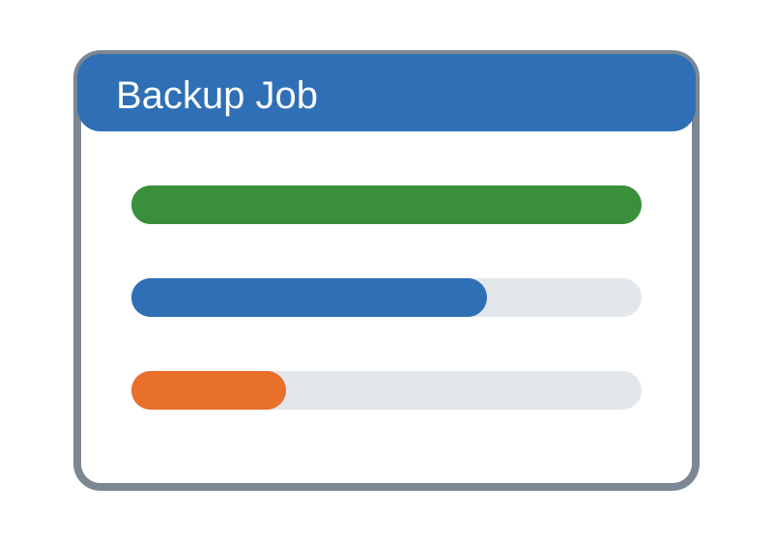
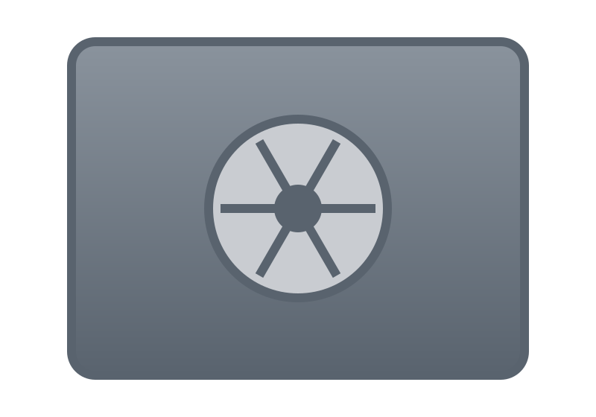
Tape Storage Backup Example
Production Server
Backup Software
Tape Library
Tape Cartridges
Tape rotation
Daily
Weekly
Monthly / archive
Offline / offsite copy
Helps protect against ransomware and disasters
30

Slide 31
Optical Drives
Optical storage
Uses laser technology
Examples: CD, DVD and Blu-ray
Advantages
Portable and inexpensive
Disadvantages
Lower capacity and slower than modern SSDs
Optical drives are increasingly uncommon
CD
DVD
Blu-ray
31

Slide 32
Optical Drives: Uses in Storage and Backup
Distribution / install media
Operating systems, applications and recovery images are supplied and installed from CD, DVD or Blu-ray.
Long-term archive / offline backup
Infrequently accessed data is kept on optical media for retention, portability or air-gapped (offline) copies.
Note: Two uses are install/recovery media and archive or offline backup. Optical media is portable and inexpensive but low in capacity.
32

Slide 33
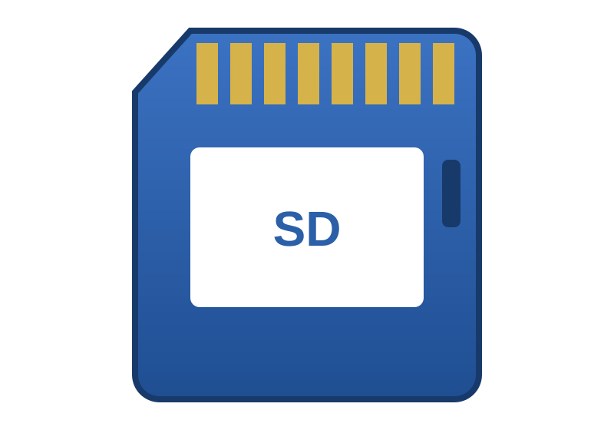
Flash Storage
What is flash storage?
Non-volatile semiconductor storage
Common technology: NAND flash
Characteristics
No moving mechanical parts
Fast access and low power consumption
Good resistance to mechanical shock compared with HDDs
SSD
USB flash drive
Memory card
Key Point: no moving parts is what separates flash from HDD and tape.
33

Slide 34
NAND Flash
NAND flash stores data using memory cells. A cell that holds more bits needs more distinguishable voltage levels.
SLC
MLC
TLC
QLC
1 bit per cell
2 bits per cell
3 bits per cell
4 bits per cell
2 voltage levels
4 voltage levels
8 voltage levels
16 voltage levels
SLC: higher endurance and cost
QLC: more capacity per cost
Note: actual endurance and performance depend on controller, NAND generation, workload and implementation.
34

Slide 35
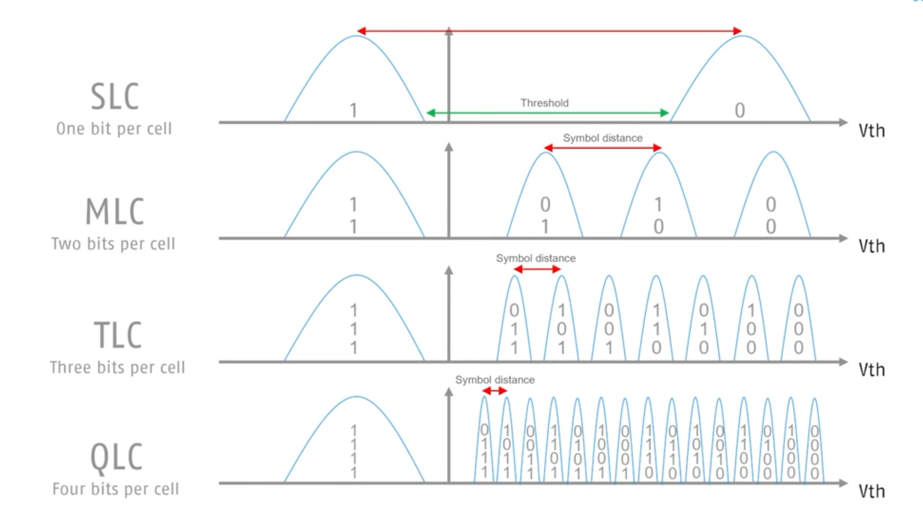

Slide 36
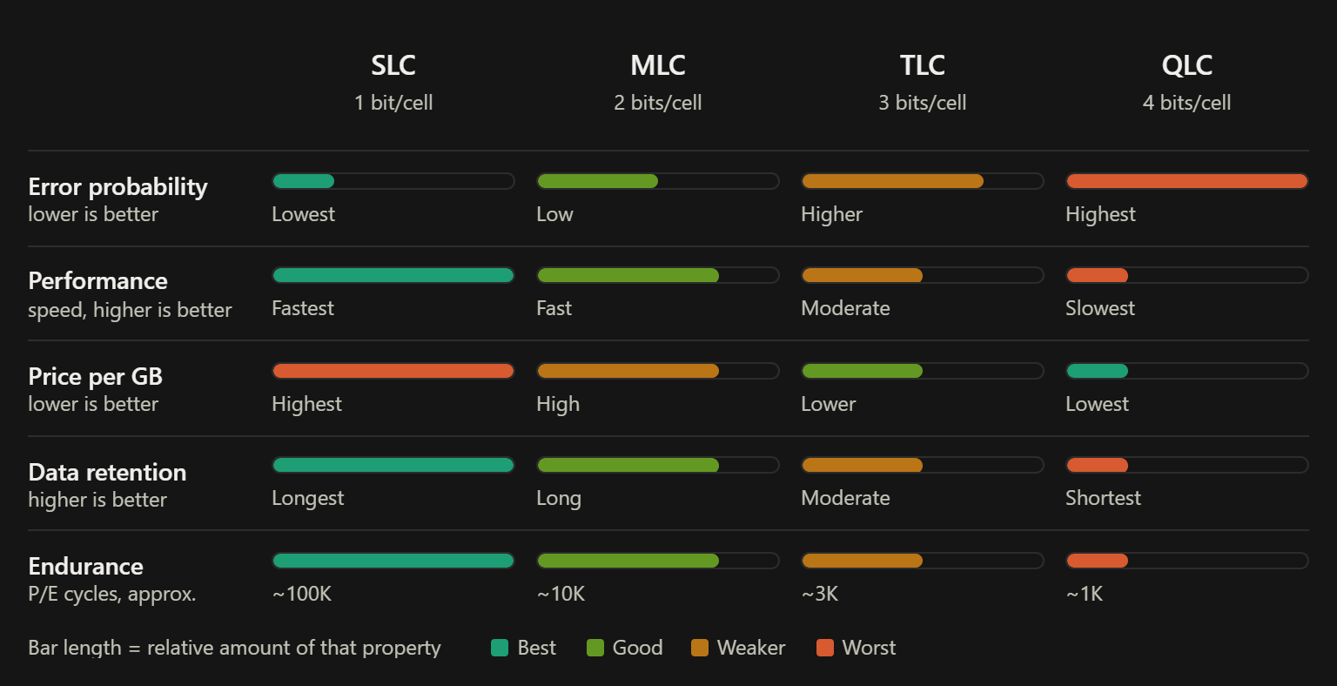

Slide 37
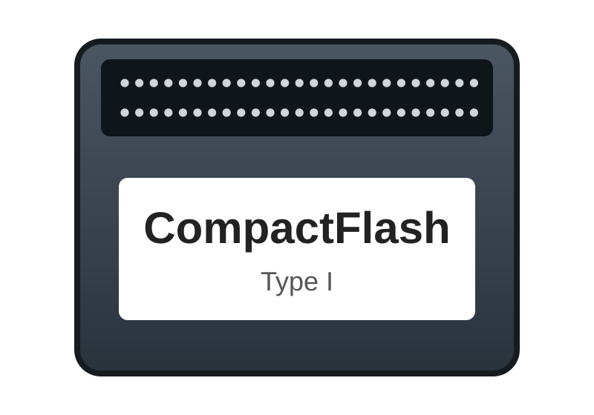
Compact Flash
What is it?
A removable flash memory format
Historically used in
Digital cameras
Embedded systems
Industrial devices
Advantages
Portable
Durable
No moving parts
CompactFlash
SD card
Today: modern devices increasingly use SD, CFexpress and other formats.
37

Slide 38
USB Storage
Advantages
Portable and easy to connect
Plug-and-play and widely supported
Risks
Loss and theft
Malware transfer
Unauthorized data copying
Security practices
Encryption and access control
Malware scanning
USB device control where required
USB flash drive
External SSD
Portable, plug-and-play, widely supported
External HDD
38

Slide 39
USB Storage and CompactFlash Devices
USB Storage
Removable storage that connects to a computer through a Universal Serial Bus (USB) port.
CompactFlash (CF)
A removable solid-state memory card format that stores data in flash memory.
Forms: flash drives (pen drives), external HDDs and external SSDs
Plug-and-play and hot-pluggable; uses the USB mass storage class
Flash drives store data in NAND flash; external drives hold an HDD or SSD
Speed depends on version: USB 2.0 up to 480 Mb/s, USB 3.x 5 to 20 Gb/s, USB4 up to 40 Gb/s
Introduced by SanDisk in 1994; card is about 43 x 36 mm
Built-in controller and an ATA (IDE) based interface, so it appears as a small disk
Type I (3.3 mm) and Type II (5 mm) cards
No moving parts: shock resistant, wide temperature range, long retention
Remember: USB is a connection standard; CompactFlash is a card format. Both are flash-based removable media.
31
Notes:
USB storage is any removable storage device that connects through the Universal Serial Bus: flash drives (pen drives) built on NAND flash, and external hard drives or SSDs. It is plug-and-play and hot-pluggable, and speed depends on the USB version (USB 2.0 up to 480 Mb/s, USB 3.x 5 to 20 Gb/s, USB4 up to 40 Gb/s). CompactFlash (CF) is a removable flash memory card format introduced by SanDisk in 1994. A CF card contains flash memory plus a controller and uses an ATA (IDE) based interface, so it looks like a small disk to the system. It has no moving parts, which makes it shock resistant and suitable for wide temperature ranges. USB is a connection standard; CompactFlash is a card format.

Slide 40
USB and CompactFlash in Server Environments
USB storage: applications
Boot and install media for operating systems and hypervisors
Firmware, BIOS and driver updates
Backup of configuration files and licence keys
Data transfer to and from isolated (air-gapped) servers
Recovery and diagnostic tools; security tokens
CompactFlash: applications
Boot or system drive for embedded servers and network appliances
Holds OS and firmware images that are mostly read, rarely written
Industrial, telecom and rugged servers with vibration or heat
Used with CF-to-SATA/IDE adapters in diskless systems
Increasingly replaced by SD cards, M.2 and SATA DOM modules
Limits: lower speed and write endurance than enterprise SSDs, so they suit boot, install, transfer and configuration roles rather than primary production data. USB ports should be controlled to prevent data leakage and malware.
32
Notes:
In servers these devices are used mainly for boot, install, transfer and configuration roles rather than primary storage. USB devices are used as bootable installation media for operating systems and hypervisors, for firmware, BIOS and driver updates, for backing up configuration files and licence keys, for moving data to or from isolated (air-gapped) servers, and for recovery tools and security tokens. CompactFlash is used as a boot or system drive in embedded servers and network appliances such as firewalls and routers, to hold operating system and firmware images that are mostly read, and in industrial, telecom and rugged servers where vibration and heat rule out spinning disks. They are not suited for heavy production workloads because of limited write endurance and lower speed than enterprise SSDs. Administrators should also control USB ports to prevent data theft and malware.

Slide 41
What is a Storage Interface?
Computer / controller
Interface
Storage device
Examples
SATA
SAS
SCSI
NVMe
USB
Important considerations
Speed
Connector
Protocol
Compatibility
Queue depth
Latency
41

Slide 42
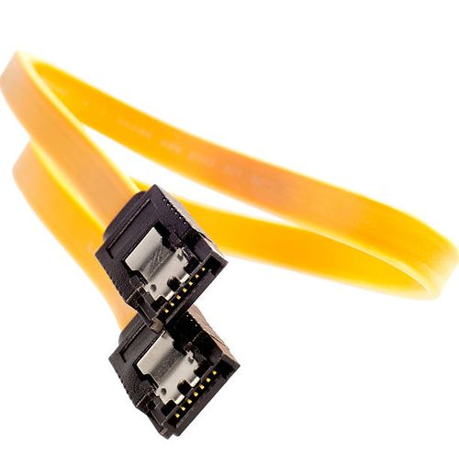
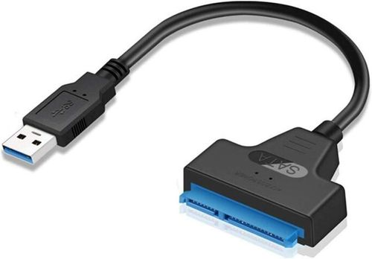
SATA
Serial ATA
Commonly used for consumer HDDs, consumer SSDs and optical drives
Low cost, wide support and simple deployment
SATA III
6 Gb/s interface signaling rate
Actual data throughput is lower because of protocol and encoding overhead
Consumer HDD
Consumer SSD
Signaling rate: 6 Gb/s
Usable throughput: lower (overhead)
Bar lengths are illustrative, not measured values.
42

Slide 43
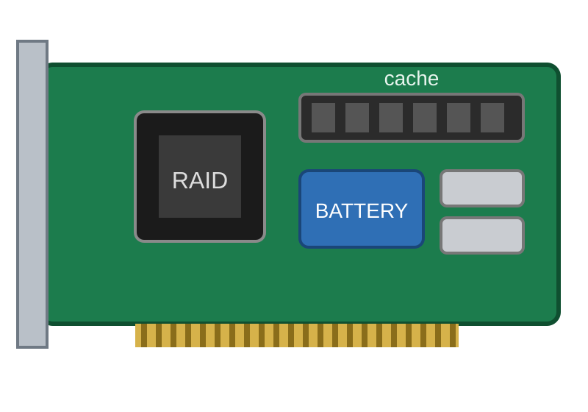
SAS
Serial Attached SCSI
Commonly used in servers and enterprise storage
High reliability
Generally designed for enterprise storage environments
Dual-port support on suitable devices
Two independent paths to the same drive
Dual-port drive
port 1
port 2
Controller A
Controller B
SAS drive
43

Slide 44
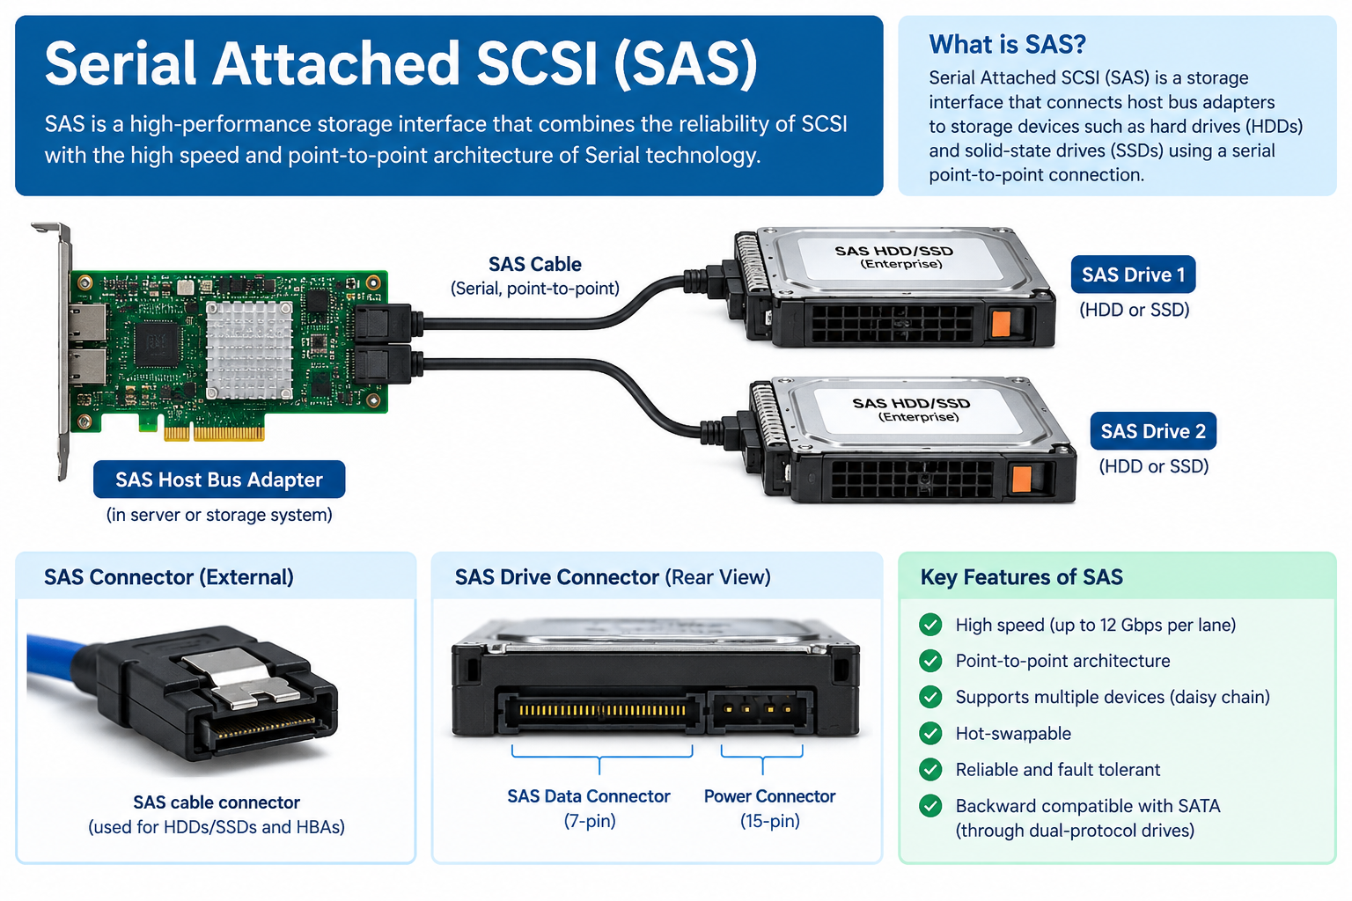

Slide 45
SAS: Key Features
Point-to-point serial links
Every device gets its own dedicated link to the controller or expander, so drives do not share bandwidth. Links are full duplex: data flows both ways at once.
High speed
3, 6, 12 and 22.5 Gb/s per lane from SAS-1 to SAS-4. Lanes can be grouped into wide ports (x4) for even more bandwidth.
Dual-port redundancy
Enterprise SAS drives have two ports, each reachable through a different controller or path, so one failure does not cut access.
Scalability
Expanders work like switches, letting one controller reach many drives and chain disk shelves.
SATA compatibility
SAS controllers and backplanes accept SATA drives too (via SATA Tunneling), but SATA controllers cannot run SAS drives.
Enterprise reliability
Hot-pluggable, strong error detection and recovery, deep command queuing and drives built for 24x7 duty.
36
Notes:
Serial Attached SCSI (SAS) is a point-to-point serial interface that carries SCSI commands and is the standard high-end drive connection in servers and storage arrays. Its main features are: dedicated full-duplex point-to-point links, so devices do not share bandwidth as in parallel SCSI; high speeds of 3, 6, 12 and 22.5 Gb/s per lane across SAS-1 to SAS-4; dual-port drives that give two independent paths for redundancy; expanders that let one controller reach a very large number of devices; compatibility with SATA drives; and enterprise-grade reliability including hot-plug, error detection and recovery, deep command queuing and drives designed for 24x7 duty.

Slide 46
SAS Architecture: Components
SAS
SAS
SATA
Initiator
HBA (Host Bus Adapter) or RAID controller
Expander
Switch-like fan-out device
Targets
SAS and SATA drives
Initiator
Starts I/O requests and sends commands. Usually an HBA or RAID controller in the server.
Expander
Connects many targets to one initiator port. Edge and fanout expanders can be chained.
Target
Receives commands and returns data: SAS or SATA drives, or storage enclosures.
Domain
The whole connected set of initiators, expanders and targets. Each has a unique 64-bit SAS address.
37
Notes:
A SAS system is built from three kinds of devices. The INITIATOR starts I/O requests; it is usually a host bus adapter (HBA) or a RAID controller in the server. The TARGET receives commands and returns data; it is a SAS or SATA drive or a storage enclosure. An EXPANDER is a switch-like device that connects many targets to a single initiator port; edge and fanout expanders can be chained to build large configurations. Together they form a SAS DOMAIN, and every device has a unique 64-bit SAS address (WWN). Each connection between two devices is a point-to-point link, so the topology scales without the shared-bus limits of parallel SCSI.

Slide 47
SAS Architecture: Protocols, Ports and Links
SAS layers
SSP
SCSI Serial Protocol: carries SCSI commands to SAS drives
Application layer SCSI and ATA commands
Transport layer SSP, STP, SMP
STP
SATA Tunneling Protocol: lets SATA drives work behind a SAS expander
Port layer Groups PHYs into ports
SMP
Serial Management Protocol: discovers and manages expanders
Link layer Addressing, connections, errors
Links and ports
PHY: one transmitter-receiver pair (a lane)
Narrow port: one PHY. Wide port: several PHYs (x2, x4) working together
Connectors: SFF-8482 (drive), SFF-8643 (internal Mini-SAS HD), SFF-8644 (external)
PHY layer Encoding, one lane
Physical layer Cables, connectors, signals
38
Notes:
SAS is organized in layers: the application layer (SCSI and ATA command sets), the transport layer (three protocols), the port layer, the link layer, the PHY layer and the physical layer (cables, connectors and signalling). Three transport protocols are used: SSP (SCSI Serial Protocol) carries SCSI commands to SAS drives; STP (SATA Tunneling Protocol) lets SATA drives operate behind a SAS expander; and SMP (Serial Management Protocol) discovers and manages expanders. A PHY is one transmitter-receiver pair, i.e. one lane. A narrow port uses a single PHY; a wide port combines several PHYs (x2, x4) between the same two devices for more bandwidth and resilience. Common connectors are SFF-8482 for the drive, SFF-8643 for internal Mini-SAS HD cabling and SFF-8644 for external cabling.

Slide 48
SAS Generations and Speeds
Data rate per lane (Gb/s)
Backward compatible
Each generation works with the previous one. Both ends negotiate the highest speed they share, so upgrades can be gradual.
SAS-1
2004
3 Gb/s
SAS-2
2009
6 Gb/s
SAS-3
2013
12 Gb/s
Wide ports multiply speed
A x4 wide port combines four lanes. With SAS-3 that is 4 x 12 = 48 Gb/s between controller and enclosure.
SAS-4
2017
22.5 Gb/s
Bars are drawn to scale. SAS-4 is marketed as 24G SAS.
39
Notes:
SAS has evolved through four published generations, each doubling or nearly doubling the per-lane rate: SAS-1 at 3 Gb/s (2004), SAS-2 at 6 Gb/s (2009), SAS-3 at 12 Gb/s (2013) and SAS-4 at 22.5 Gb/s (2017, marketed as 24G SAS). A wide x4 port multiplies these figures by four. Each generation is backward compatible, and the two ends negotiate the highest speed both support, so an organization can upgrade controllers and drives gradually. A faster generation is in development, and NVMe is increasingly used where the lowest flash latency is needed.

Slide 49
SAS vs SATA for Enterprise Workloads
Feature | SAS | SATA
Typical use | Enterprise servers and storage arrays | Desktops, laptops, bulk storage
Ports per drive | Dual port (redundant paths) | Single port
Transfer mode | Full duplex | Half duplex
Speed per lane | Up to 22.5 Gb/s (SAS-4) | 6 Gb/s (SATA III)
Command queue | Deep (up to 254 commands) | 32 commands (NCQ)
Cable length | Up to about 10 m | About 1 m
Scalability | Expanders: thousands of devices | One drive per port
Duty and reliability | Built for 24x7 duty, low error rates | Lighter duty cycles
Cost per GB | Higher | Lower
Key Point: SAS trades higher cost for redundancy, speed and scale, which is why it dominates enterprise arrays.
40
Notes:
SAS and SATA share the same physical drive bay shape, but they are designed for different jobs. SAS drives have two ports, are full duplex, run at up to 22.5 Gb/s per lane, support deep command queues (up to 254 commands compared with 32 for SATA NCQ), allow cables up to about 10 m and scale through expanders to very large numbers of drives. They are built for 24x7 duty and have lower unrecoverable error rates. SATA drives are single port, half duplex, limited to 6 Gb/s and about 1 m of cable, but they cost much less per GB, so they suit bulk and archival capacity.

Slide 50
Why SAS Suits Enterprise Storage
Fast full-duplex links and deep command queues serve databases and virtual machines.
Typical deployments
Back-end drives of SAN and NAS arrays
Disk shelves chained with expanders
Database, ERP and virtualization servers
SAS HDDs (10K, 15K rpm) and SAS SSDs
Performance
Reliability
Dual ports, strong error handling and drives built for continuous 24x7 duty.
Availability
Multipath I/O, hot-plug drives and redundant controllers remove single points of failure.
Limitations
Higher cost per GB than SATA
Needs a SAS HBA or controller
NVMe gives lower flash latency
Scalability
Expanders and JBOD enclosures add capacity without redesigning the system.
Key Point: SAS fits critical workloads that need high throughput and no single point of failure; SATA suits bulk capacity and NVMe the lowest latency.
41
Notes:
SAS suits critical enterprise workloads because it meets the four main requirements. Performance: fast full-duplex links and deep queues serve databases and virtual machines. Reliability: dual ports, strong error handling and drives built for continuous duty. Availability: multipath I/O, hot-plug drives and redundant controllers remove single points of failure. Scalability: expanders and JBOD enclosures grow capacity without redesign. Typical uses are the back-end drive connections of SAN and NAS arrays, disk shelves chained with expanders, and RAID controllers in database, ERP and virtualization servers, using SAS HDDs (10K or 15K rpm) and SAS SSDs. Limitations are higher cost than SATA, the need for a SAS HBA or controller, and the lower latency offered by NVMe for flash. In summary, SAS is a strong fit when throughput and no single point of failure matter most.

Slide 51
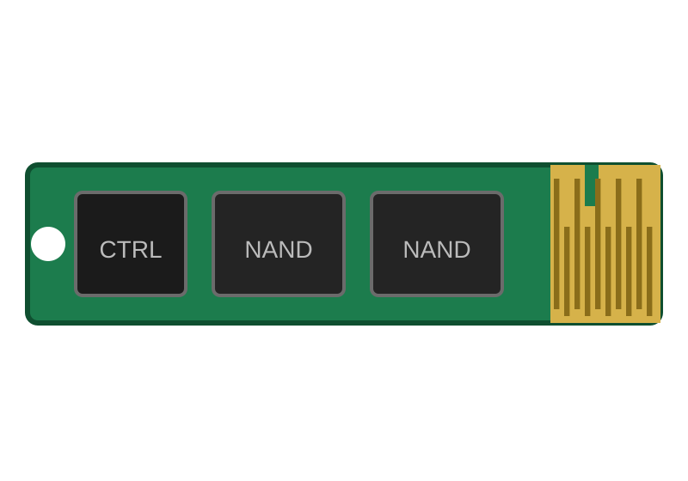
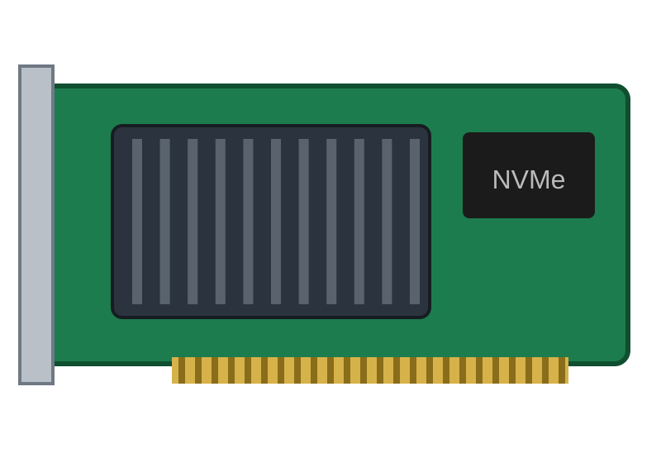
NVMe
Non-Volatile Memory Express
Designed for high-speed flash storage
Uses PCI Express
Low latency, high throughput and large command queues
Path to the CPU
CPU
PCIe
NVMe SSD
Flash devices connect over PCIe rather than through a legacy disk interface.
Common form factors
M.2
U.2 / U.3
PCIe add-in card
51

Slide 52
SCSI
Small Computer System Interface
Traditional SCSI used a parallel interface
Historically used in servers, workstations and storage systems
Important
SCSI can refer to a family of standards and command architecture
SAS is a modern serial transport for SCSI commands
SCSI command architecture
Parallel SCSI
SAS
iSCSI
Traditional transport
Serial transport
Over IP networks
The same commands, carried by different transports.
52

Slide 53
SCSI to SAS: Evolution
Aspect | Parallel SCSI | SAS (Serial Attached SCSI)
Transport | Parallel shared bus | Serial point-to-point links
Cable length | Limited | Longer (up to about 10 m)
Scalability | Shared bus; device limit | Expanders connect thousands of devices
Redundancy | Single port | Dual-port drives, multipath
Commands | SCSI command set | Same SCSI command set; SATA drives also supported
Key Point: same commands, different transport. iSCSI carries SCSI over IP; SAS is a dedicated serial interconnect.
53

Slide 54
SATA vs SAS vs NVMe
SATA
SAS
NVMe
 | SATA | SAS | NVMe
Positioning | Common consumer / entry storage interface | Enterprise-oriented interface | High-performance flash storage protocol
Strengths | Low cost, wide support | Strong reliability and management features | Low latency, high throughput
Designed for | HDDs and SSDs | HDDs and SSDs | Non-volatile memory devices over PCIe
54

Slide 55
HDD: Hard Disk Drive
Platter
Advantages
High capacity
Lower cost per GB
Disadvantages
Mechanical components
Higher latency, noise
Generally higher power consumption
Read/write head
Actuator arm
Spindle
How it works: platters rotate while the heads read and write magnetic data.
55

Slide 56
SSD: Solid State Drive
NAND flash
Advantages
Low latency, high IOPS
Silent operation
Better shock resistance
Disadvantages
Often higher cost per GB
Finite flash write endurance
Controller
DRAM / cache
Connector
Components: NAND flash, controller, firmware and DRAM/cache depending on design.
56

Slide 57
HDD vs SSD
HDD
SSD
 | HDD | SSD
Technology | Magnetic, with moving parts | Flash, no moving parts
Random access / latency | Slower, higher latency | Generally faster, lower latency
Capacity per cost | Generally more capacity per unit cost | Often higher cost per GB
Commonly used for | Bulk storage where capacity and cost are priorities | Operating systems, applications, high-performance workloads
57

Slide 58
IOPS: A Disk Performance Specification
Definition
IOPS (Input/Output Operations Per Second) is the number of read and write operations a disk or storage system can complete in one second.
Why it matters
Used to specify and compare performance, especially for random workloads such as databases and virtual machines
HDDs typically deliver lower IOPS; SSDs and well-designed RAID arrays deliver much higher IOPS
Key Point: capacity planning balances capacity (TB) with performance (IOPS and latency).
58

Slide 59
Storage Deployment
Plan
Install
Configure
Maintain
Storage deployment is planning, installing, configuring and maintaining storage. Consider:
Capacity
Performance
Availability
Redundancy
Security
Backup
Cost
Future expansion
Key Point: these factors pull against each other (for example performance vs cost), so the design is a balance.
59

Slide 60
Storage Deployment Example
Requirement: 100 employees need shared documents and centralized backup
100 employees
Network
NAS + RAID storage
Backup
Add
User authentication
Access permissions
Backup
Important: RAID is not a substitute for backup.
60

Slide 61
Storage Tiers:
Data | Best media | Why suitable | Cost per GB
Databases | NVMe SSD | Lowest latency, high IOPS, large command queues | Highest
Backups and bulk data | SATA HDD | High capacity at low cost; random access acceptable | Moderate
Archives | Tape | Very low cost per TB, offline and long retention; sequential, slow access | Lowest
Deployment effect: placing hot data on fast media and cold data on cheap media gives needed performance without paying SSD prices for everything.
61

Slide 62
Storage Units
× 1,000
× 1,000
TB
× 1,000
GB
10^12 bytes
× 1,000
MB
1,000,000,000 bytes
KB
1,000,000 bytes
Byte
1,000 bytes
Bit
8 bits
smallest unit
Note: a byte is 8 bits; each decimal step multiplies by 1,000.
62

Slide 63
Base-10 vs Base-2
Decimal (base-10) | Bytes | Binary (base-2) | Bytes
1 KB | 1,000 | 1 KiB | 1,024
1 MB | 1,000,000 | 1 MiB | 1,048,576
1 GB | 1,000,000,000 | 1 GiB | 1,073,741,824
1 TB | 10^12 | 1 TiB | 2^40 = 1,099,511,627,776
Powers of 1,000, commonly used by storage manufacturers
Powers of 1,024. GB / MB / TB are decimal; GiB / MiB / TiB are binary
63

Slide 64
Why Does a 1 TB Drive Show Less Capacity?
Drive properties
binary
Capacity: ≈ 0.909 TiB
(about 931 GiB)
1 TB drive
Manufacturer: 1,000,000,000,000 bytes
1,000,000,000,000 ÷ 1,099,511,627,776 ≈ 0.909 TiB
Key Point: the drive has not lost capacity; the units are different.
64

Slide 65
Storage Calculation Practice
Question: A disk contains 2 TB. Calculate approximately how many TiB it represents.
Step 1: Convert to bytes
Step 2: Divide by 2^40
Step 3: Result
2 TB = 2,000,000,000,000 bytes
2,000,000,000,000 ÷ 1,099,511,627,776
≈ 1.82 TiB
Formula: TiB = decimal bytes ÷ 2^40
65

Slide 66
RAID Capacity Calculation
Level | Usable capacity | Example
RAID 0 | number of drives × drive capacity | 4 × 2 TB → 8 TB
RAID 1 | two-drive mirror = capacity of one drive | 2 × 2 TB → 2 TB
RAID 5 | (N − 1) × smallest drive | 4 × 2 TB → 6 TB
RAID 6 | (N − 2) × smallest drive | 6 × 4 TB → 16 TB
RAID 10 | ≈ 50% of raw capacity | 4 × 2 TB → 4 TB
Note: RAID 6 with 4 drives = (4 − 2) × 2 TB = 4 TB. Raw capacity is 8 TB in every case.
67

Slide 67


Disk Quotas
Disk quota
Limits the amount of storage a user or group can consume
Purpose
Prevent one user from consuming all available storage
Improve resource management
Department: 500 GB
Example: Employee A 10 GB, Employee B 20 GB, Department 500 GB.
Employee A: 10 GB
Employee B: 20 GB
69

Slide 68
Types of Quotas
User quota
Group quota
Soft quota
Hard quota
Limit storage for an individual user
Limit storage for a group
Warning threshold
Maximum allowed storage
Example: soft limit 8 GB, hard limit 10 GB
0 GB
8 GB: soft limit, warning
10 GB: hard limit
Key Point: a soft quota warns the user; a hard quota stops further use of space.
70

Slide 69
Data Compression
What is compression?
Reduces the amount of storage required by data
Can also reduce bandwidth usage
Two major types
Lossless
Lossy
compress
Original file
Smaller file
Lossless
Lossy
Original fully recovered
Some information removed
71

Slide 70
Lossless Compression
Exact copy
Lossless compression
The original data can be completely recovered
Examples: ZIP, GZIP and PNG
Uses: documents, logs, software files, backups
Nothing is lost, so it is safe for backups and logs.
ZIP
GZIP
PNG
compress
decompress
Original log file
Compressed
Restored
100 MB
30 MB
100 MB, identical
72

Slide 71


Lossy Compression
Lossy compression
Permanently removes some information
Examples: JPEG, MP3 and many video codecs
Trade-off
Advantage: much smaller files
Disadvantage: original data cannot be perfectly reconstructed
compress
Original
After compression
Illustration: the compressed copy keeps the overall picture but loses fine detail that cannot be brought back.
Key Point: lossy suits media where small losses are acceptable; use lossless for data that must be exact.
73

Slide 72
Storage Capacity Planning
Current data
Daily growth
Number of users
Required capacity
Retention period
Backups
RAID overhead
Snapshots
Replication
Future growth
Predicts current and future storage requirements
74

Slide 73
Storage Growth Calculation
Given
Current data 5 TB, growth 200 GB per month, 12 months
Annual growth
200 GB × 12 = 2.4 TB
After one year
5 TB + 2.4 TB = 7.4 TB
Also plan for: RAID, backups, snapshots, free space and future growth.
75

Slide 74
What is RAID?
Redundant Array of Independent Disks
Combines multiple physical disks into a logical storage system
Different RAID levels give different combinations of benefits
Disk 1
Disk 2
Disk 3
Disk 4
···
···
···
···
RAID can provide
Performance
Redundancy
Server
One logical RAID volume
Availability
Capacity aggregation
77

Slide 75
RAID Concepts
Striping
Mirroring
Parity
Disk 1
Disk 2
Disk 1
Disk 2
Disk 1
Disk 2
Disk 3
A1
A2
A1
A1
A1
A2
P(A)
A3
A4
A2
A2
B1
B2
P(B)
Splitting data across multiple disks
Copying data to multiple disks
Additional information used to reconstruct lost data
Key Point: the RAID level defines how data, copies and parity are organized.
78

Slide 76
RAID 0
Striping without redundancy
Minimum drives: 2
Capacity = N × smallest drive capacity
Advantages
High performance
Full combined capacity
Disadvantage
No fault tolerance
If one drive fails, the entire array can become unavailable
Data striped across disks
Data in
Disk 1
Disk 2
A1
A2
A3
A4
A5
A6
Data
79

Slide 77
RAID 1
Mirroring
Minimum drives: 2
Data written to two or more mirrored drives depending on configuration
Advantages
Redundancy
Simple recovery
Disadvantage
≈ 50% usable capacity for a two-drive mirror
Example: 2 × 2 TB → ≈ 2 TB usable
Same data on both disks
Data in
Disk 1
Disk 2
A1
A1
A2
A2
A3
A3
Data
Mirror copy
80

Slide 78
RAID 5
Striping with distributed single parity
Minimum drives: 3
Fault tolerance: one drive failure
Capacity = (N − 1) × smallest drive
Example: 4 × 2 TB → ≈ 6 TB usable
Note
Rebuilds can be lengthy, especially with large drives
Data and parity spread over all disks
Data in
Disk 1
Disk 2
Disk 3
Disk 4
A1
A2
A3
Pa
B1
B2
Pb
B3
C1
Pc
C2
C3
Pd
D1
D2
D3
Data
Parity
81

Slide 79
RAID 6
Striping with double distributed parity
Minimum drives: 4
Fault tolerance: two drive failures
Capacity = (N − 2) × smallest drive
Example: 6 × 4 TB → ≈ 16 TB usable
Two parity blocks per stripe
Data in
Disk 1
Disk 2
Disk 3
Disk 4
A1
A2
Pa
Qa
B1
Pb
Qb
B2
Pc
Qc
C1
C2
Qd
D1
D2
Pd
Data
Parity P
Parity Q
82

Slide 80
RAID 10
Mirroring combined with striping
Minimum drives: 4
High performance and good redundancy
Usable capacity ≈ 50% of raw (equal-sized drives)
Example: 4 × 2 TB → ≈ 4 TB usable
Mirrored pairs, striped together
Data in
Disk 1
Disk 2
Disk 3
Disk 4
A1
A1
A2
A2
A3
A3
A4
A4
A5
A5
A6
A6
Data
Mirror copy
83

Slide 81
RAID Comparison
Level | Min. drives | Method | Fault tolerance | Usable capacity
RAID 0 | 2 | Striping | None | N × disk capacity
RAID 1 | 2 | Mirroring | Survives loss of a mirror drive | ≈ 50% (two-drive mirror)
RAID 5 | 3 | Striping + single parity | One drive | (N − 1) × disk
RAID 6 | 4 | Striping + double parity | Two drives | (N − 2) × disk
RAID 10 | 4 | Mirrored stripes | Good redundancy | ≈ 50% of raw
Higher fault tolerance usually costs usable capacity.
84

Slide 82
RAID Visual Concept
RAID 0
RAID 1
RAID 5
RAID 6
RAID 10
D1
D2
D1
D2
D1
D2
D3
D1
D2
D3
D1
D2
D3
D4
A1
A2
A1
A1
A1
A2
Pa
A1
Pa
Qa
A1
A1
A2
A2
A3
A4
A2
A2
B1
Pb
B2
Pb
Qb
B1
A3
A3
A4
A4
Pc
C1
C2
Qc
C1
Pc
Striped
Mirrored
Distributed parity
Double parity
Mirrored pairs, striped
Data
Mirror copy
Parity P
Parity Q
86

Slide 83
Hardware RAID
Dedicated RAID controller manages the array
May include cache and battery / flash-backed cache protection
Advantages
Dedicated processing
Centralized management
Enterprise features
Disadvantages
Additional cost
Controller dependency
Server / OS
Drive 1
Drive 2
RAID controller
Cache + battery
Drive 3
87

Slide 84
Software RAID
Managed by the OS or storage software
Windows Storage Spaces
Linux mdadm
ZFS RAIDZ
Advantages
Lower hardware cost
Flexibility
Disadvantages
Uses system resources
Features depend on the OS / software
Server
Operating system
Drive 1
RAID software (mdadm, Storage Spaces, ZFS)
Uses CPU and RAM
Drive 2
Drive 3
88

Slide 85
Hardware RAID vs Software RAID
Hardware RAID
Software RAID
 | Hardware RAID | Software RAID
Control | Dedicated controller | OS / software controlled
Cost | Higher cost | Lower hardware cost
Management | Controller-based | Often flexible
Choice depends on: performance, management, budget and platform requirements.
89

Slide 86
Hardware RAID vs Software RAID
Criterion | Hardware RAID | Software RAID
Performance | Dedicated controller and cache offload RAID calculations | Uses host CPU and RAM
Cost | Extra controller cost | Lower hardware cost
Reliability | Battery or flash-backed cache protects writes; controller is a dependency | Depends on OS and software; features vary by platform
Role of cache and battery backup
Cache speeds writes by holding data before it reaches the disks
Battery or flash-backed cache keeps cached writes safe through power loss so they can be written to disk later
Key Point: hardware RAID favours performance and features; software RAID favours low cost and flexibility.
90

Slide 87
Hot Swap
Replace hardware while the system stays powered on
Storage example: A failed HDD is removed and a replacement inserted while the system remains operational
Requirements
Hot-swap capable enclosure / backplane
Compatible controller
Operating system support
Note: Not every storage device or drive bay supports hot swapping.
Hot-swap drive bays
91

Slide 88
Hot Swap Example
RAID 5 system: one drive fails while the other drives remain operational
Step 1
Step 2
Step 3
Step 4
Step 5
A drive fails; the others keep running
Administrator identifies the failed drive
Remove it with the supported hot-swap procedure
Insert the replacement drive
RAID rebuild begins
Disk A
Disk B
Disk C
Disk D
Disk A
Disk B
Disk C
Disk D (new)
···
···
···
···
···
···
···
rebuild
✕
During rebuild: users may continue accessing the system, depending on platform and workload.
92

Slide 89
Hot Spare
A backup drive already installed in the system
Controller can assign it automatically or manually
Rebuild starts without waiting for an administrator
Reduced time in a degraded state
Before
After failure
D1
D2
D3
Spare
D1
Spare
D3
···
···
···
idle
···
rebuild
···
✕
Spare takes the failed disk's place; rebuild starts automatically
Key Point: a hot spare is connected and ready before any failure happens.
93

Slide 90
Cold Spare
A replacement drive stored separately, not connected
Administrator installs it after a failure
Simple, and needs no dedicated active drive
Requires manual intervention and may take longer
Cold spare on a shelf
Array with failed drive
Administrator
Administrator installs the spare after a failure
94

Slide 91
Hot Spare vs Cold Spare
Hot spare
Cold spare
Installed and ready
Stored offline
 | Hot spare | Cold spare
State | Connected and ready for use | Offline, requires installation
Rebuild | Potentially automatic | After manual installation
Response time | Generally reduced | Longer
Key Point: a hot spare generally reduces response time.
95

Slide 92
Hot-swap, Hot Spare and Cold Spare: Effect on Downtime
Strategy | What it is | Effect on downtime | Effect on rebuild
Hot-swap | Replace a drive while the system stays powered on | No shutdown needed to replace the drive | Rebuild starts once the replacement is inserted
Hot spare | Idle drive already installed in the array | Shortest degraded period | Starts automatically, no waiting for an administrator
Cold spare | Replacement stored offline | Longest: manual installation first | Starts only after manual install; array stays degraded longer
Key Point: hot-swap is the ability to replace a drive while powered; a hot spare is an idle drive already installed and ready to rebuild.
96

Slide 93
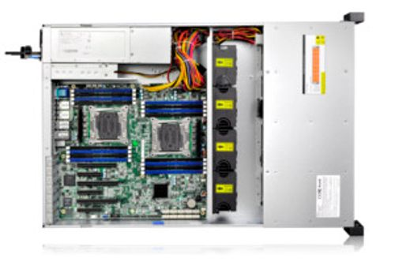
What is an Array Controller?
A hardware or software component that manages storage arrays
RAID configuration and disk monitoring
Striping, mirroring and parity calculations
Rebuild operations and fault detection
Hardware RAID controllers may include
Cache
Battery-backed or flash-backed write-cache protection
RAID controller card (illustration)
Inside a rack server: the board where controller cards connect
97

Slide 94
RAID Controller Workflow
Operating System
RAID Controller
RAID Array
Physical Drives
The controller handles
Read / write requests
RAID calculations
Drive status
Rebuilds
Alerts
98

Slide 95
Storage Architecture: Putting Everything Together
Application
Server
Storage protocol
Storage network
Storage array
RAID controller
RAID
HDD / SSD
Key Point: different environments combine different protocols, interfaces and RAID levels.
99

Slide 96
Enterprise Storage Example
Requirement: database server with high availability and high performance
Storage array
SSD
SSD
SSD
SSD
Spare
···
···
···
···
hot
Application / database server
SAN (Fibre Channel or iSCSI)
RAID 10 + enterprise SSDs + hot spare
Backup, replication and disaster recovery
100

Slide 97
Small Office Storage Example
Requirement: 20 employees need file sharing and centralized backup
20 employee PCs
Ethernet switch
NAS
RAID storage
Security
User authentication
Permissions
Encryption
Backup
101

Slide 98
Storage Security
Physical security
Protects
Confidentiality
Integrity
Availability
Measures
Access control
Encryption at rest and in transit
Authentication
Audit logging and secure deletion
Access control
Encryption
Data
Layers of protection around the data
102

Slide 99
RAID Is Not Backup
Threat | RAID | Backup (separate copy)
Disk failure | Yes, depending on the level | Yes, restore from the copy
Accidental deletion | Not necessarily | Yes
Ransomware | Not necessarily | Yes, especially offline / offsite copies
Corruption | Not necessarily | Yes
Fire or theft | Not necessarily | Yes, with an offsite copy
Best practice
RAID
+
Backup
+
Disaster Recovery
103

Slide 100
